Slide 1
Data Structure and Algorithm (CS-102)
Ashok K Turuk

Slide 2
Binary Search Tree (BST)
Suppose T is a binary tree
Then T is called binary search tree if each node N of T has the following property
The value at N is greater than every value in the left sub-tree of N and is less than every value in the right sub-tree of N

Slide 3
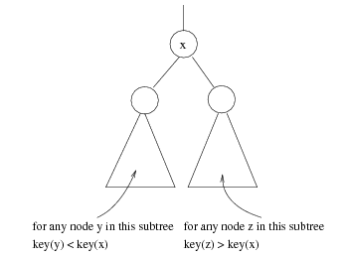
x
For any node z in this subtree key(z) > key(x)
For any node y in this subtree key(y) < key(x)

Slide 4
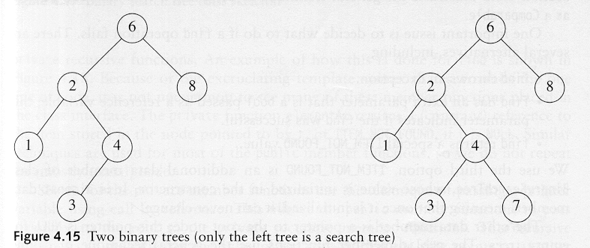
Binary Search Trees
A binary search tree
Not a binary search tree

Slide 5
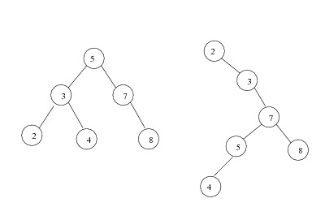
Binary search trees
Two binary search trees representing the same set:
Average depth of a node is O(log N); maximum depth of a node is O(N)

Slide 6
Searching and Inserting in BST
Algorithm to find the location of ITEM in the BST T or insert ITEM as a new node in its appropriate place in the tree
[a] Compare ITEM with the root node N of the tree
(i) If ITEM < N, proceed to the left child of N
(ii) If ITEM > N, proceed to the right child of N

Slide 7
Searching and Inserting in BST
Algorithm to find the location of ITEM in the BST T or insert ITEM as a new node in its appropriate place in the tree
[b] Repeat Step (a) until one of the following occurs
(i) We meet a node N such that ITEM = N. In this case search is successful
(ii) We meet an empty sub-tree, which indicates that search is unsuccessful and we insert ITEM in place of empty subtree

Slide 8
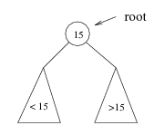
Searching BST
If we are searching for 15, then we are done.
If we are searching for a key < 15, then we should search in the left subtree.
If we are searching for a key > 15, then we should search in the right subtree.

Slide 9
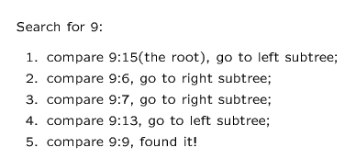
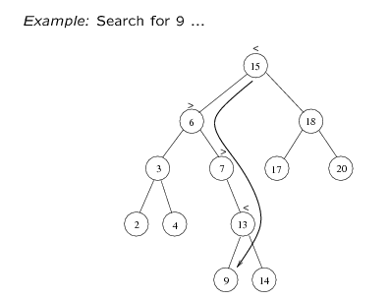

Slide 10
Insert 40, 60, 50, 33, 55, 11 into an empty BST
40
40
40
40
60
60
60
33
1. ITEM = 40
50
50
2. ITEM = 60
3. ITEM = 50
4. ITEM = 33

Slide 11
Insert 40, 60, 50, 33, 55, 11 into an empty BST
40
40
60
33
60
33
50
11
50
55
55
5. ITEM = 55
6. ITEM = 11

Slide 12
Locating an ITEM
A binary search tree T is in memory and an ITEM of information is given. This procedure finds the location LOC of ITEM in T and also the location of the parent PAR of ITEM.

Slide 13
Locating an ITEM
Three special cases:
[1] LOC == NULL and PAR == NULL, tree is empty
[2] LOC ≠ NULL and PAR == NULL, ITEM is the root of T
[3] LOC == NULL and PAR ≠ NULL, ITEM is not in T and can be added to T as child of the node N with location PAR.

Slide 14
FIND(INFO,LEFT,RIGHT,ROOT,ITEM,LOC,PAR)
[1] [Tree empty ?]
If ROOT == NULL, then
Set LOC = NULL, PAR = NULL, Exit
[2] [ITEM at root ?]
If ROOT->INFO == ITEM, then
Set LOC = ROOT, PAR = NULL, Exit
[3] [Initialize pointer PTR and SAVE]
If ITEM < ROOT->INFO then
Set PTR = ROOT->LEFT, SAVE = ROOT
Else
Set PTR = ROOT->RIGHT, SAVE =ROOT

Slide 15
[4] Repeat Step 5 and 6 while PTR ≠ NULL
[5] [ITEM Found ?]
If ITEM == PTR->INFO, then
Set LOC = PTR, PAR = SAVE, Exit
[6] If ITEM < PTR->INFO, then
Set SAVE = PTR, PTR = PTR->LEFT
Else
Set SAVE = PTR, PTR = PTR->RIGHT
[7] [Search Unsuccessful]
Set LOC = NULL, PAR = SAVE
[8] Exit

Slide 16
A binary search Tree T is in memory and an ITEM of information is given. Algorithm to find the location LOC of ITEM in T or adds ITEM as a new node in T at location LOC.

Slide 17
[1] Call FIND(INFO, LEFT,RIGHT,ROOT,ITEM,LOC,PAR)
[2] If LOC ≠ NULL, then Exit
[3] [Copy the ITEM into the node NEW]
(a) Create a node NEW
(b) NEW->INFO = ITEM
( c) Set LOC = NEW, NEW->LEFT = NULL, NEW->RIGHT = NULL

Slide 18
[4] [Add ITEM to tree]
If PAR = NULL
Set ROOT = NEW
Else
If ITEM < PAR->INFO, then
Set PAR->LEFT = NEW
Else
Set PAR->RIGHT = NEW
[5] Exit

Slide 19
Binary Search Tree
Insert Algorithm
If value we want to insert < key of current node, we have to go to the left subtree
Otherwise we have to go to the right subtree
If the current node is empty (not existing) create a node with the value we are inserting and place it here.

Slide 20
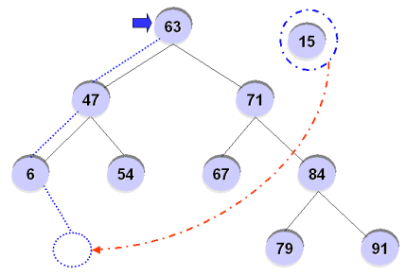
Binary Search Tree
For example, inserting ’15’ into the BST?

Slide 21
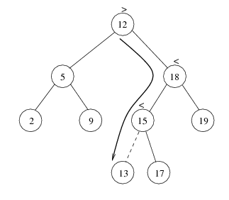

Slide 22
Deletion from BST
T is a binary tree. Delete an ITEM from the tree T
Deleting a node N from tree depends primarily on the number of children of node N

Slide 23
Deletion
There are three cases in deletion
Case 1. N has no children. N is deleted from the T by replacing the location of N in the parent node of N by null pointer
40
33
60
11
50
55
ITEM = 11

Slide 24
Deletion
Case 2. N has exactly one children. N is deleted from the T by simply replacing the location of N in the parent node of N by the location of the only child of N
40
33
60
11
50
55
ITEM = 50

Slide 25
Deletion
Case 2.
40
33
60
11
55
ITEM = 50

Slide 26
Deletion
Case 3. N has two children. Let S(N) denote the in-order successor of N. Then N is deleted from the T by first deleting S(N) from T and then replacing node N in T by the node S(N)
40
33
60
11
50
55
ITEM = 40

Slide 27
Deletion
Case 3.
40
50
33
60
33
60
11
55
11
55
Delete 50
Replace 40 by 50

Slide 28
Types of Binary Trees
Degenerate – only one child
Balanced – mostly two children
Complete – always two children
Degenerate binary tree
Balanced binary tree
Complete binary tree

Slide 29
Binary Trees Properties
Degenerate
Height = O(n) for n nodes
Similar to linear list
Balanced
Height = O( log(n) ) for n nodes
Useful for searches
Degenerate binary tree
Balanced binary tree

Slide 30
Binary Search Trees
Key property
Value at node
Smaller values in left subtree
Larger values in right subtree
Example
X > Y
X < Z
X
Y
Z

Slide 31
Binary Search Trees
Examples
5
10
10
2
45
5
30
5
45
30
2
25
45
2
25
30
10
25
Binary search trees
Non-binary search tree

Slide 32
Example Binary Searches
Find ( 2 )
10
5
10 > 2, left
5 > 2, left
2 = 2, found
5 > 2, left
2 = 2, found
5
30
2
45
2
25
45
30
10
25

Slide 33
Example Binary Searches
Find ( 25 )
10
5
10 < 25, right
30 > 25, left
25 = 25, found
5 < 25, right
45 > 25, left
30 > 25, left
10 < 25, right
25 = 25, found
5
30
2
45
2
25
45
30
10
25

Slide 34
Binary Search Properties
Time of search
Proportional to height of tree
Balanced binary tree
O( log(n) ) time
Degenerate tree
O( n ) time
Like searching linked list / unsorted array
Requires
Ability to compare key values

Slide 35
Binary Search Tree Construction
How to build & maintain binary trees?
Insertion
Deletion
Maintain key property (invariant)
Smaller values in left subtree
Larger values in right subtree

Slide 36
Binary Search Tree – Insertion
Algorithm
Perform search for value X
Search will end at node Y (if X not in tree)
If X < Y, insert new leaf X as new left subtree for Y
If X > Y, insert new leaf X as new right subtree for Y
Observations
O( log(n) ) operation for balanced tree
Insertions may unbalance tree

Slide 37
Example Insertion
Insert ( 20 )
10
10 < 20, right
30 > 20, left
25 > 20, left
Insert 20 on left
5
30
2
25
45
20

Slide 38
Binary Search Tree – Deletion
Algorithm
Perform search for value X
If X is a leaf, delete X
Else // must delete internal node
a) Replace with largest value Y on left subtree
OR smallest value Z on right subtree
b) Delete replacement value (Y or Z) from subtree
Observation
O( log(n) ) operation for balanced tree
Deletions may unbalance tree

Slide 39
Example Deletion (Leaf)
Delete ( 25 )
10
10
10 < 25, right
30 > 25, left
25 = 25, delete
5
30
5
30
2
25
45
2
45

